Slide 1


Smart Data
Saqib Razzaq

Slide 2
Datasets
CSV file Containing Video games Dataset
Columns: 17 Dataset: 19714
Dataset:
Id, name title, IMDB URL, Year of release, certificate ratings , average rating, number of votes, summary plot, Action is game of action genre?, Adventure is game of adventure genre?,Comedy, Crime, Family, Fantasy, Mystery, Sci-Fi, Thriller.

Slide 3
Mapping
Prompt Engineering :
Using ChatGPT Version GPT-4
Convert CVS file dataset into RDF.
RML Generation
One-Shot
Few-Shot
Convert CVS file dataset into RDF.
RML Generation
Zero-Shot
One-Shot
Few-Shot

Slide 4
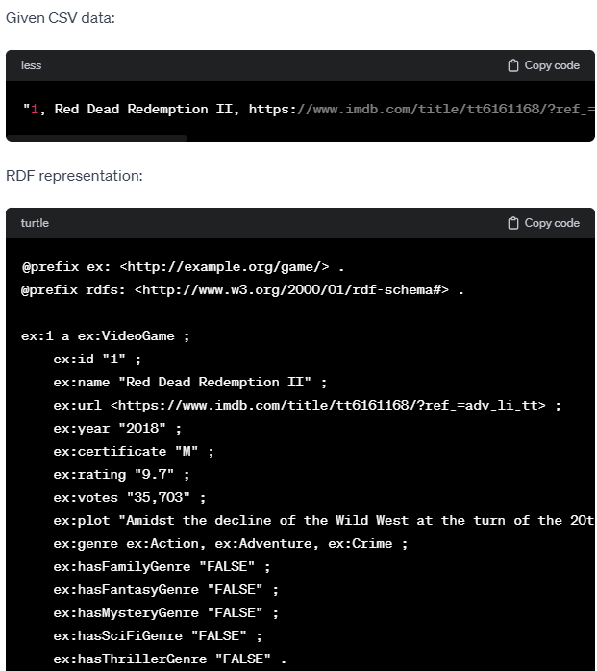
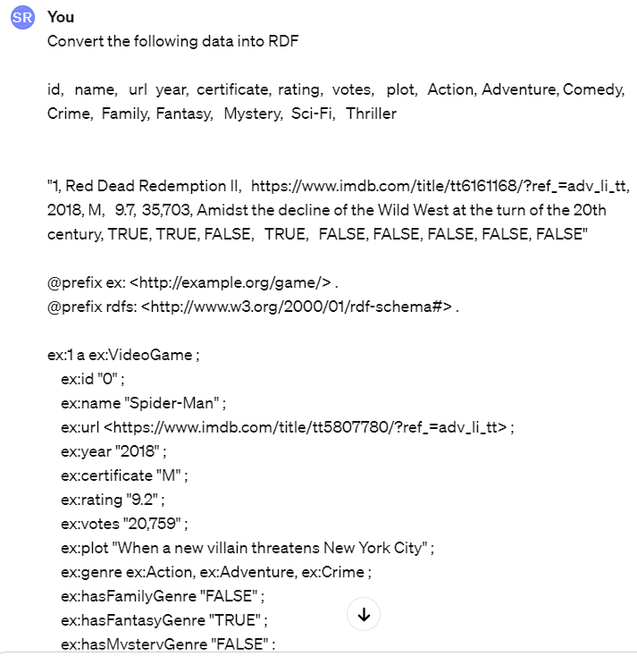

RDF Generation.
One-shot

Slide 5
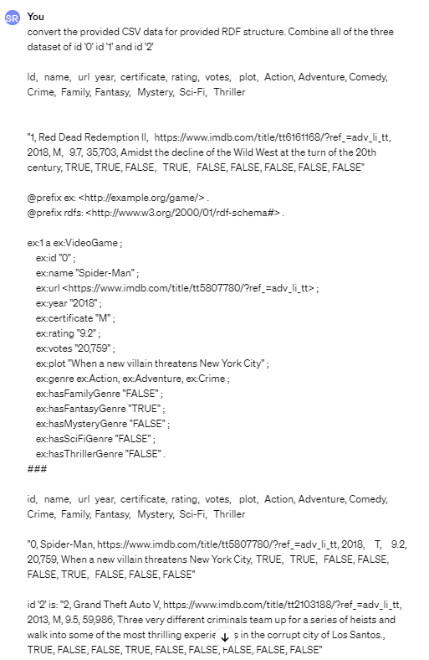
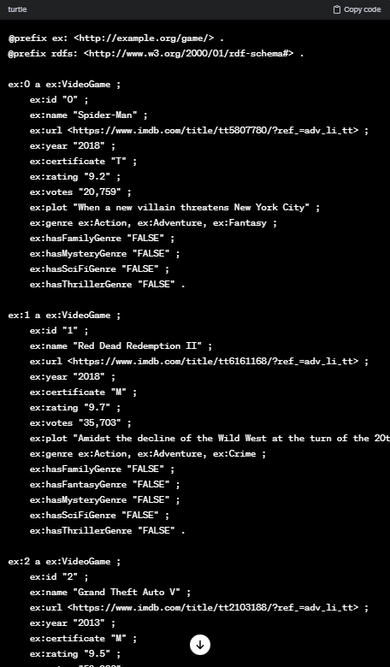
RDF Generation.
Few-shots
Give Multiple Input to get the for
Completing The request

Slide 6
Mapping
Prompt Engineering :
Using ChatGPT Version GPT-4
Convert CVS file dataset into RML.
RML Generation
Zero-Shot
One-Shot
Few-Shot

Slide 7
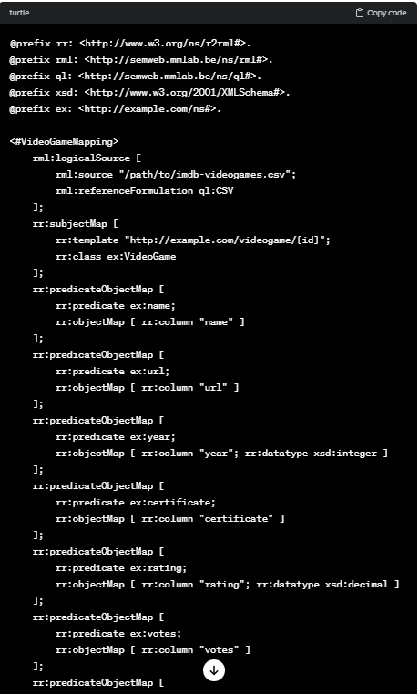
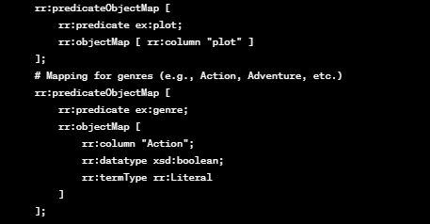
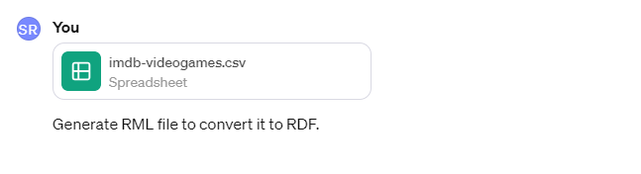
RML Generation.
Zero-shot
No previous information and data
is provided for the completing request.

Slide 8
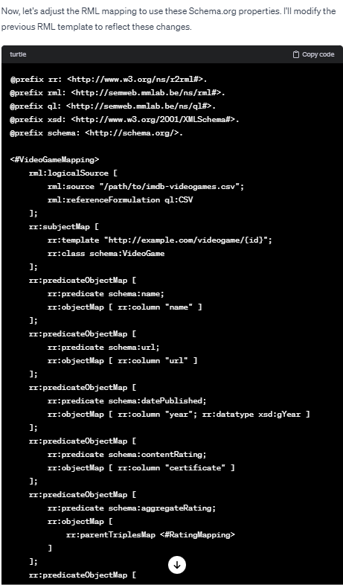
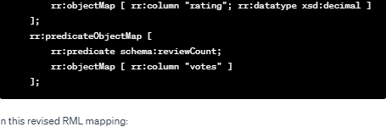
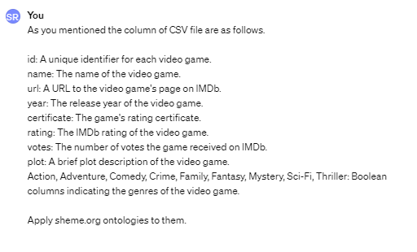
RML Generation.
Zero-shot
Appling Scheme.org Ontologies for rml

Slide 9
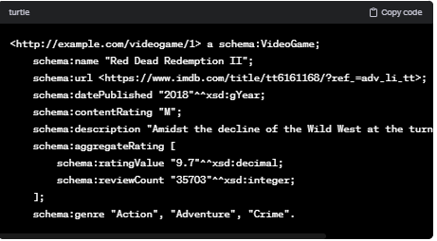
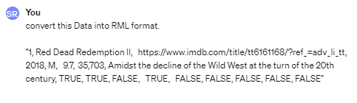
RML Generation.
One-shot
One Specific Input is provided and given out is
in scheme.org ontologies.

Slide 10
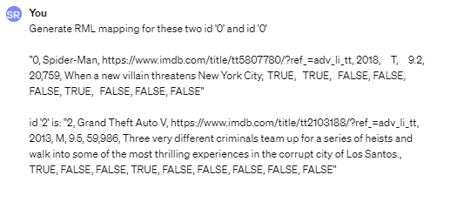
RML Generation.
Few-shots
Multiple pieces of data or guidelines given before completing request
Generate Mapping for first two Unique ID: id ’0’ and id ‘1’

Slide 11
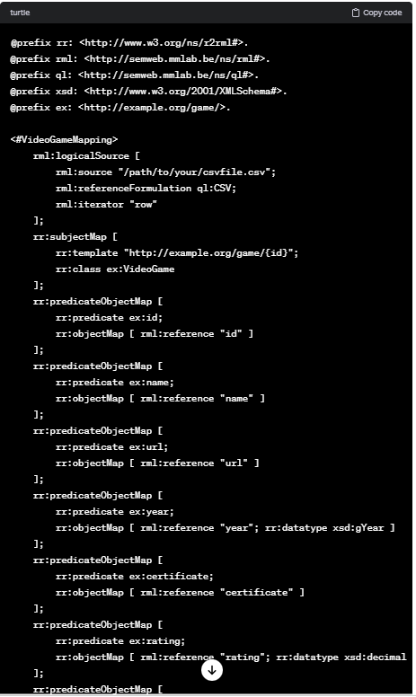
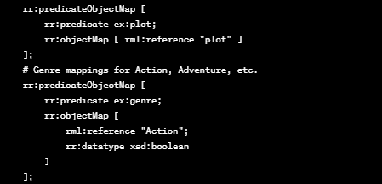
RML Generation.
Few-shots

Slide 12

Thank You

